Slide 1
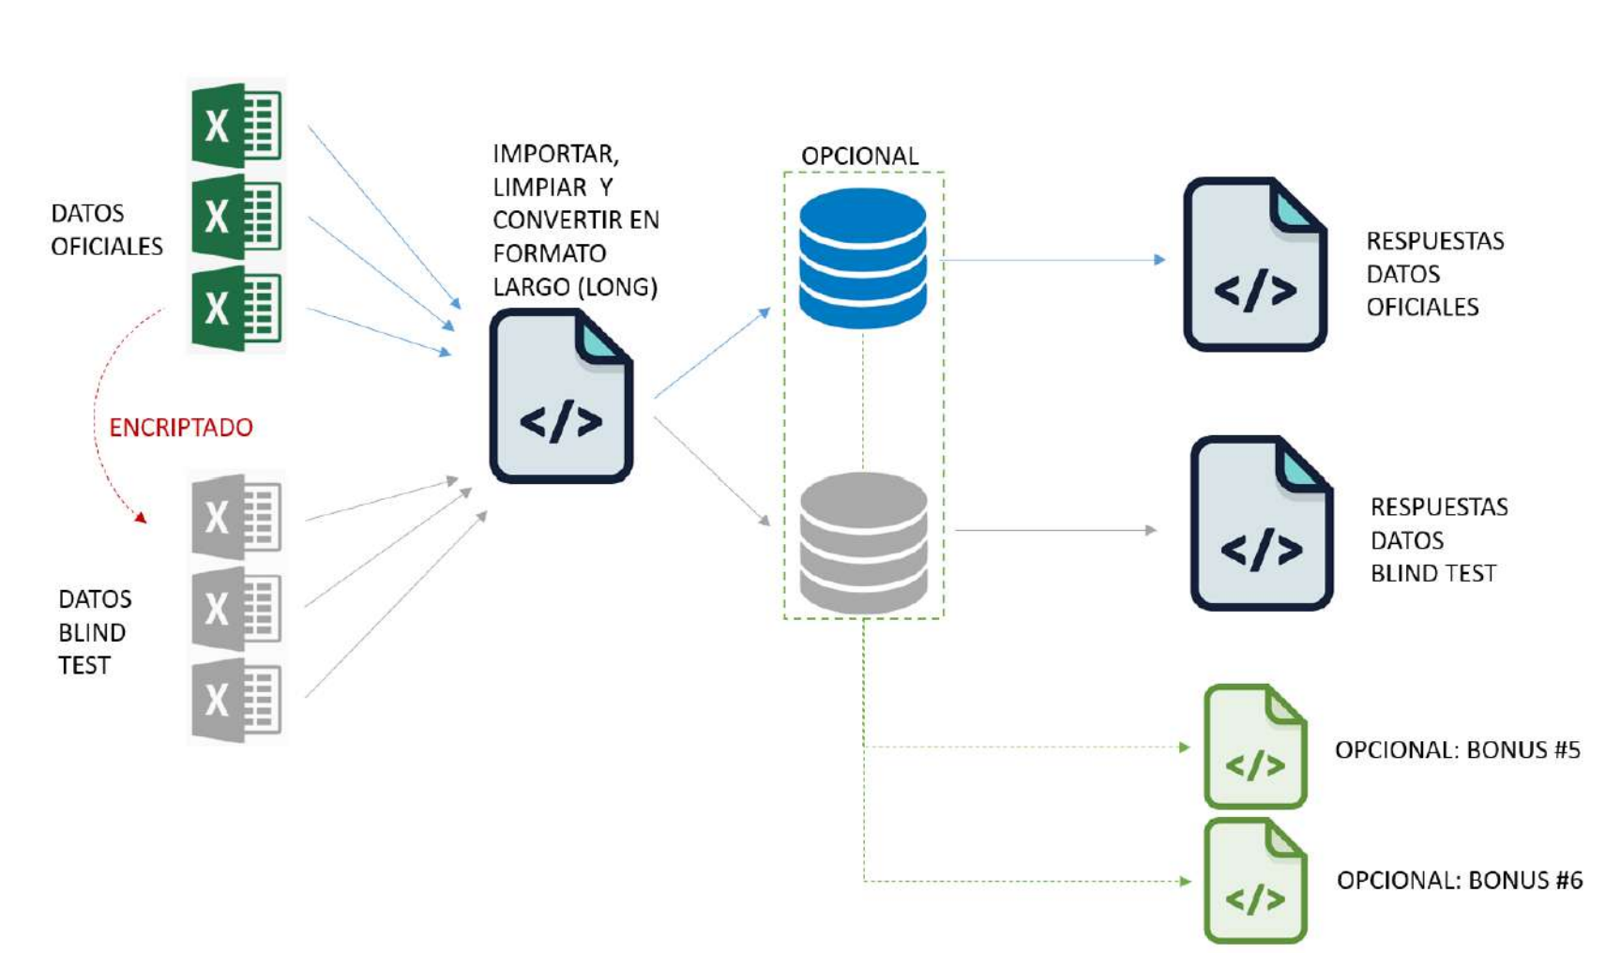
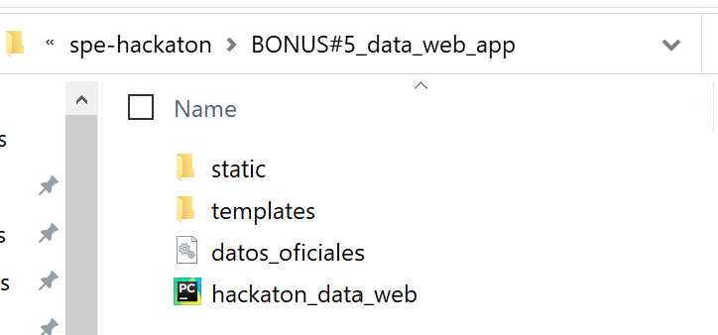
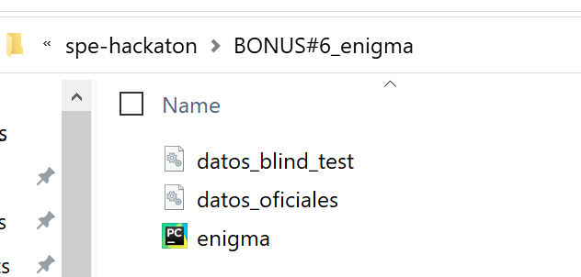
datos_oficiales.db
process_oficial_data.py
(no arguments – data base names by default in folder)
datos_blind_test.db
process_blind_data.py
(no arguments – data base names by default in folder)
read_and_process.py (arguments in line command:
auto – (in case to get files from web)
List_file1.xlsx …… files2.xlsx

Slide 2
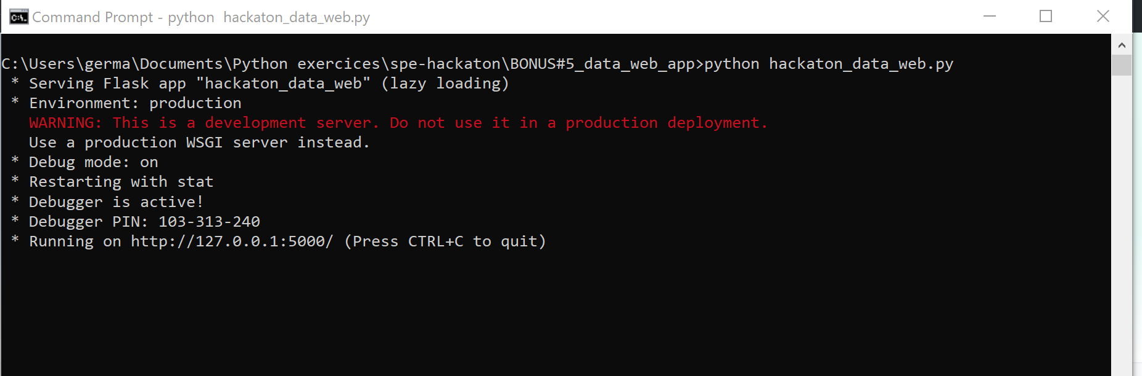
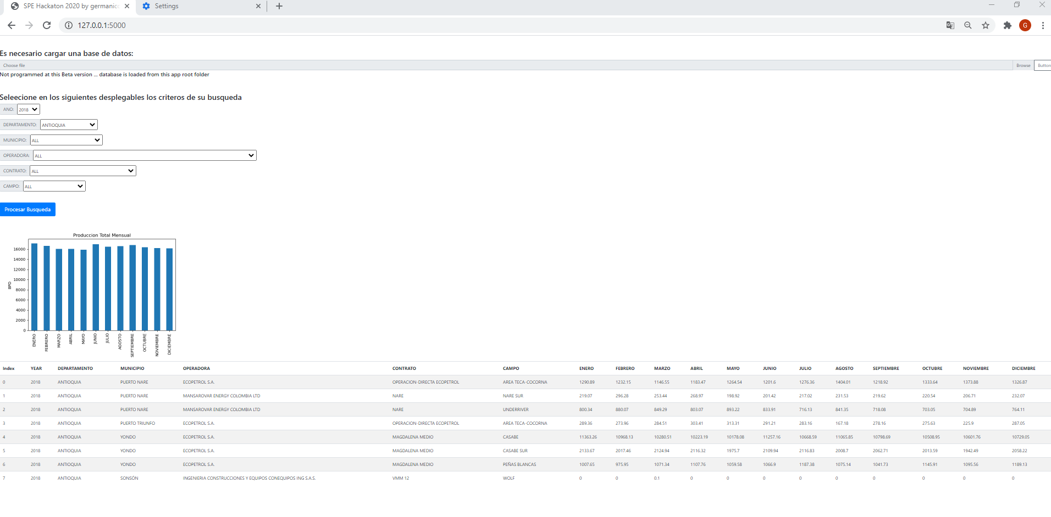
Bonus 5 – web app
Need to install Flask
pip install flask

